Slide 1



Mash Screen
Fast sequence containment estimation using MinHash
Brian Ondov

Slide 2
Previously on…
M*A*S*H

Slide 3
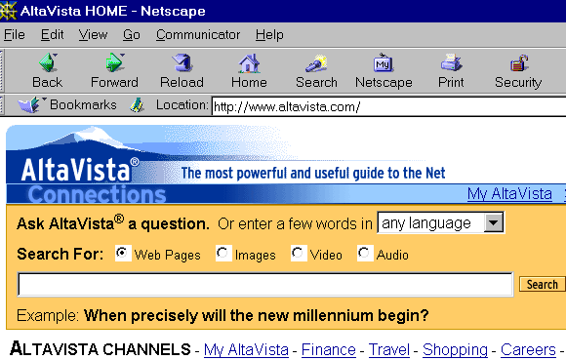
MinHash
Andrei Broder, 1997
“On the resemblance and containment of documents”

Slide 4
MinHash
Documents
Sketches
A
B

Slide 5
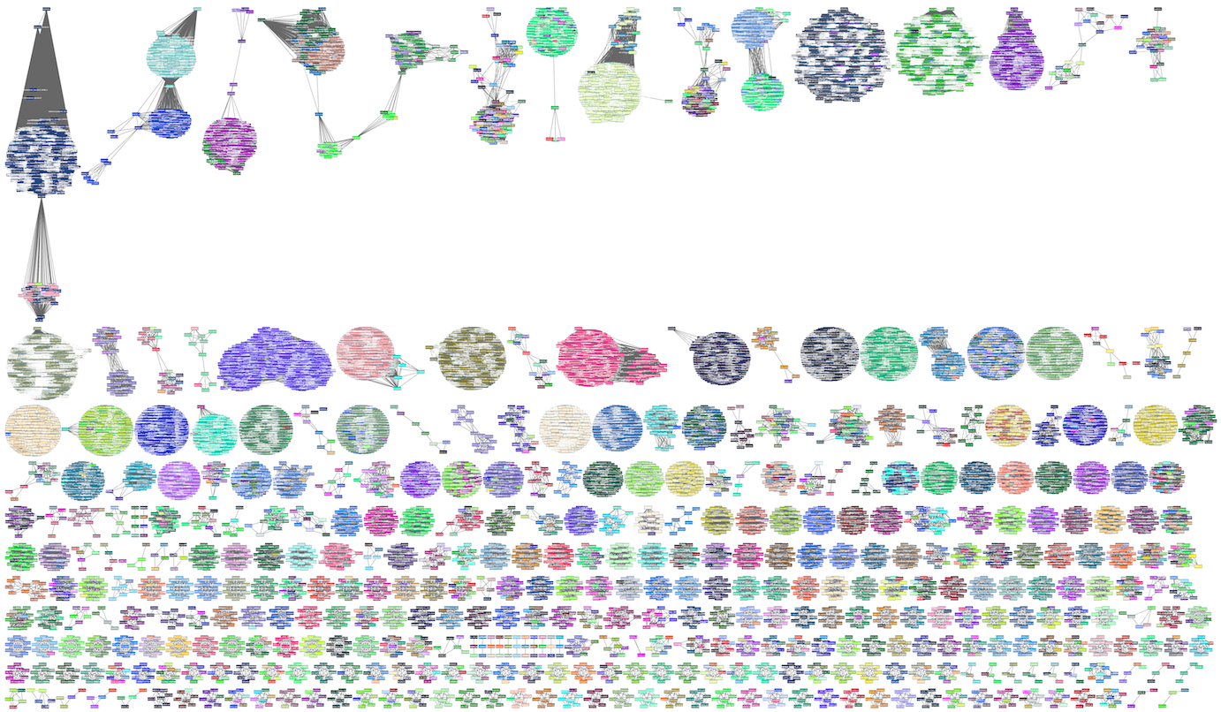
Mycobacterium
tuberculosis
Klebsiella pneumoniae
B. cereus group
Escherichia coli & Shigella
Acinetobacter baumannii
Streptococcus agalactiae

Slide 6
Resemblance
Containment
A
B
A
B

Slide 7
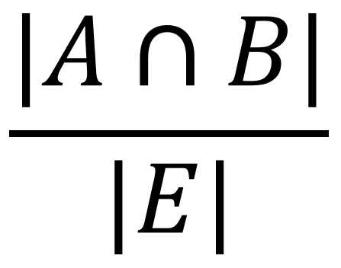
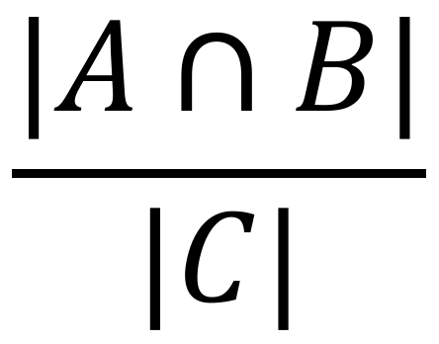
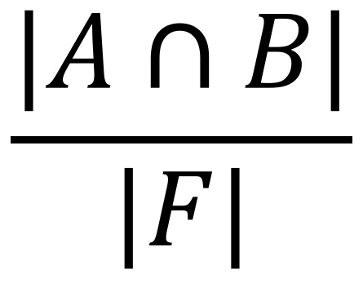
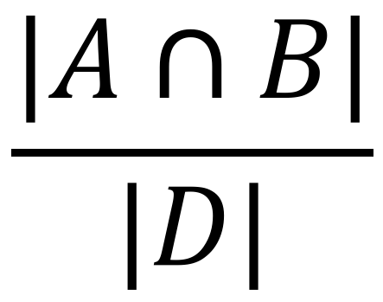
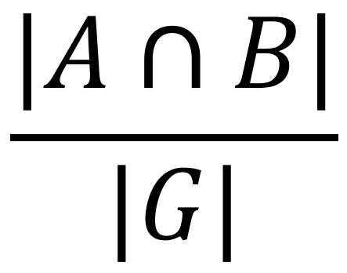
Containment – problem
F
B
G
A
E
D
C

Slide 8

Containment – solution (screen)
Reads
Containment
estimates
References
Sketches

Slide 9

Six-frame screening of reads for proteomes
Reads
Containment
estimates
Proteomes
Sketches

Slide 10
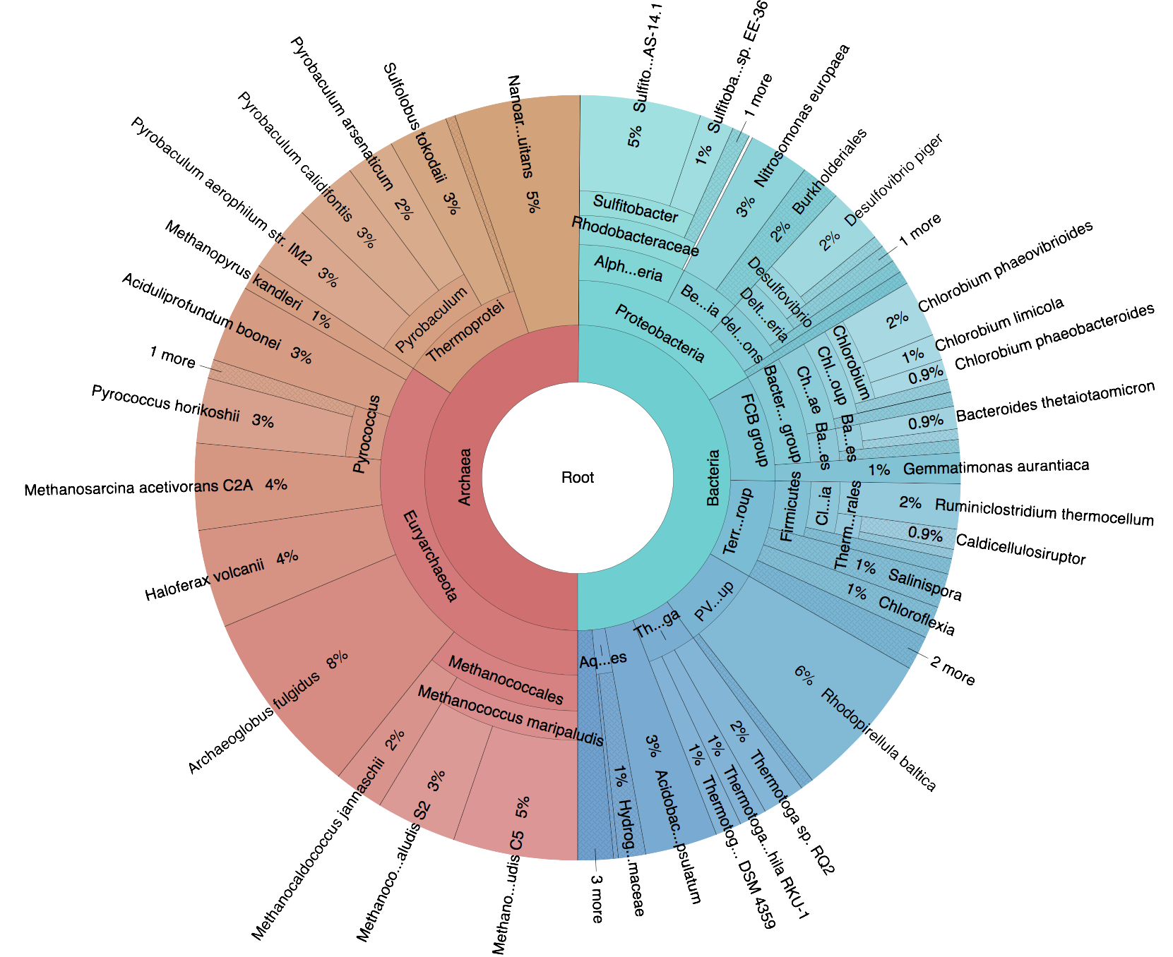
Validation
Shakya et al., 2013
Synthetic metagenome
64 Bacteria + Archaea
200-fold abundance range
Illumina HiSeq 2000
11.1 Gb
SRR606249

Slide 11
Validation
Refseq genomes
Recruit to Shakya
Expected screen:
Bin by Shakya genome with Mash distance
Screen
distance
Log
p-val
Mash distance

Slide 12
Contamination
Awad et al., 2017 (preprint)
E. coli
Proteiniclasticum ruminis
Mash Screen
Propionibacterium acnes
Streptococcus parasanguinis

Slide 13
Contamination
Read mapping
64 genomes + 4 contaminants
Organism | Reads | Coverage | Identity
Escherichia coli strain 2014C-3250 | 59,744 | 4.99% | 95.16%
Proteiniclasticum ruminis DSM 24773 | 751,538 | 76.57% | 91.83%
Propionibacterium acnes HL072PA1 | 36,222 | 7.29% | 96.36%
Streptococcus parasanguinis strain C1A | 74,807 | 57.50% | 95.84%

Slide 14
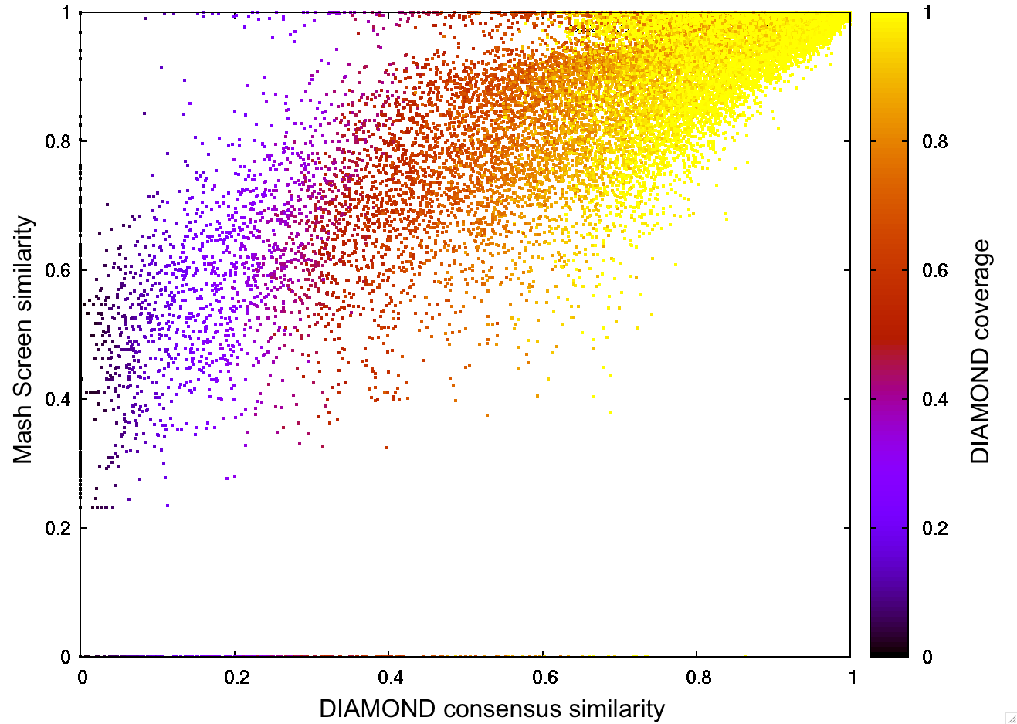
Six-frame validation
HMP ORFs
Reads
DIAMOND mapping
Consensus identity
Screen against genes
r²=0.70

Slide 15
Performance
8 Gb per cpu-hour
Multithreaded
10-15Gb RAM

Slide 16

Uses

Slide 17
Contamination
ERR024951
…
Organism | Reads | Coverage | Identity
Salmonella enterica subsp. enterica serovar Typhi str. CT18 | 1,962,751 | 88.91% | 98.64%
Klebsiella pneumoniae strain k1037 | 10,726,719 | 98.76% | 99.96%

Slide 18
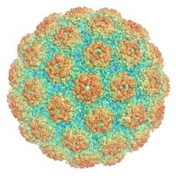
Reverse query?

Slide 19
Containment – solution (screen)
Reads
Containment
estimates
References
Sketches

Slide 20
SRA metagenomes vs. RefSeq
~100,000 runs
~100,000 genomes
~10,000,000,000 containment estimates
x
440 cpu-days

Slide 21
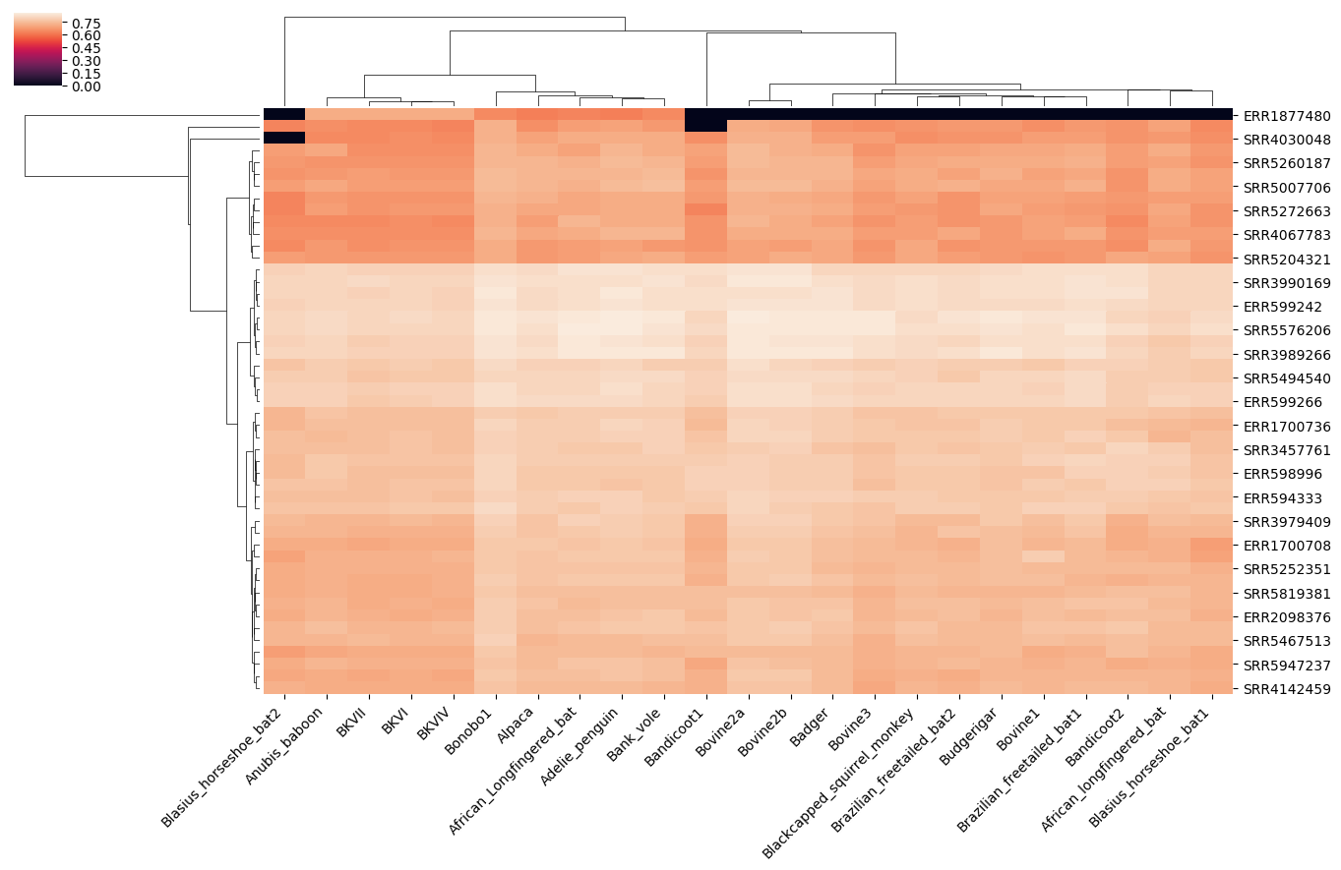

Slide 22
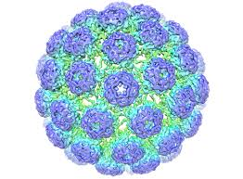
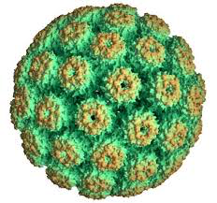

Novel virus discovery
RefSeq
SRA

Slide 23
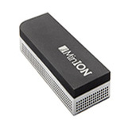

Slide 24

Acknowledgements
Adam Phillippy
Alex Dithey
Serge Koren
http://mash.readthedocs.org
Anna Sappington
http://github.com/marbl/mash
Aleks Kostic
http://genomeinformatics.github.io/mash-screen/
Notes:
What about Koslick and Zabeti?
Their bloom filter approach is elegant but not necessary if you assume that you have the reads and are streaming through them anyway. However, it could aid in building a database of runs, rather than genomes, so the methods are somewhat complementary.
Why not use modulo database with the streaming method
Would work, but varying error bounds
Compatibility with mash dist
Couldn’t spurious translations create false positives?
The p-value is computed for the number of unique hashes for all translations – meaning that it will reflect the probability of random matches

